Slide 1
Python programming
unit 1 – basic data type

Slide 2
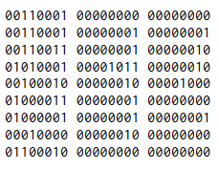
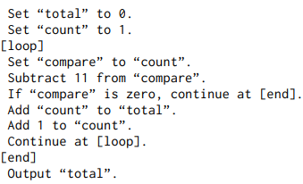
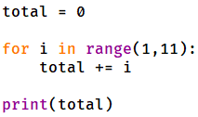

What is programming
Programming: Instructing computer to do work and solve targeted problem
Programming language: an artificially created language use to instruct computer
Machine code
Assemble code
High-level programming language

Slide 3
starting
Download and install Python on your computer
http://www.python.org, downloads
Using IDLE
File -> New File, in a new window type your first Python code and save the file
Run -> Run Module or simply press “F5”, to run your first Python program.
Check the result from IDLE shell window.
Try see some errors
Change your code, see what happen is missing one “ ) ”, or missing one “ ’ ”. Try run it and see.
Change print to “pront”, “Print”, something else, try run it and see

Slide 4
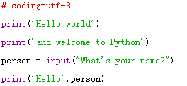
starting
Comments
Output one line of string Hello world to stdout (the shell window when using IDLE)
Output one line of string and welcome to Python to stdout
Print What’s your name? and wait for user key in one string, Enter key to finish
Output one line of string combines Hello and the string user just entered

Slide 5

Variable: name, reference to value with ‘=‘
A variable has a name. the name is an identifier, must in accord with the naming rules:
Can use letters and numbers
Can use underscore ‘_’
First one cannot be numbers, can be letters, or ‘_’
Do not use keywords and build in function names as your identifiers
A variable can be assigned a value using assignment operator ‘=‘:
It is not math ‘=‘. It is assignment, assign the right value to the left variable
i = i+1, is valid. Can short for i+=1, same effect.
del statement delete the specified variable
Which is valid identifier?
i _sys_val _Time
M23 8tick $cost
#middle print if
True user_name total_price

Slide 6
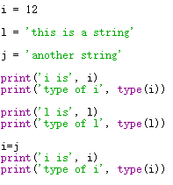
Variable: dynamic, duck typing
Unlike many other programming language, Python does not give variables types. (Dynamic language, duck typing)
In Python, types are for value (or data). After a variable is assigned a value, the variable will have that data type.
Variable ‘i’ is created, and assigned value 12, which is an integer number. Thus it is with type <int>
Variable ‘i’ is changed with new assignment. Thus now it is with type <str>

Slide 7
Literals
Numeric literals: for data value of integer and float(decimal)
Boolean literals: True and False
String and character literals: for data of texts and letters
Difference between string literal and numeric literal: 3.1 vs ‘3.1’, and 10 vs ‘10’
Special literal: None

Slide 8
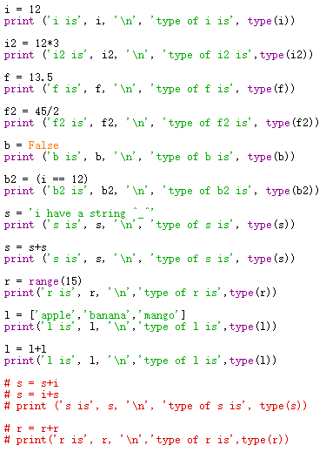
Data Types
int
float
bool
str
tuple
list
…

Slide 9



In class practice: what is the result for those code?

Slide 10
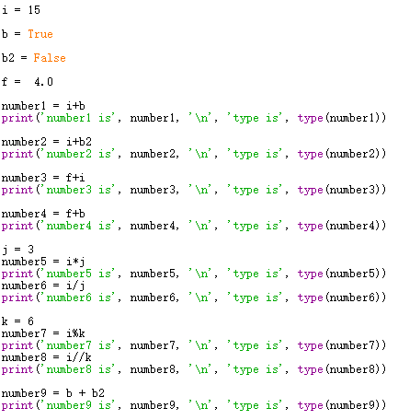
Operators
Arithmetic operators
+, -, *, /, %, //, **
Implicit conversion
when one operand is float, the other one is integer or bool, it will be converted to float
when one operand is integer, the other one is bool, it will be converted to integer
True be converted to 1 or 1.0
False be converted to 0 or 0.0
two bool operands will be converted to integer
‘/’ will convert both operands to float

Slide 11




In class practice : what is the result for those code?

Slide 12
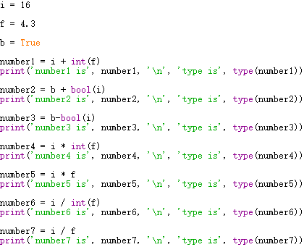
explicit Type conversion
explicit data type conversion function
bool()
int()
float()

Slide 13
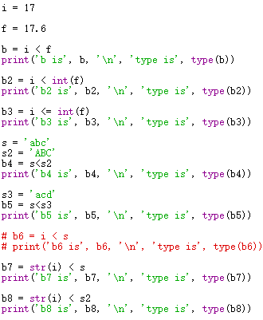
Comparison operator
==, !=, >, <, <=, >=

Slide 14




In class practice : what is the result for those code?

Slide 15
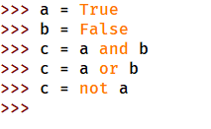
boolean operator
and --- both must be True
or --- at least one must be True
not --- take the reverse

Slide 16


In class practice : what is the result for those code?

Slide 17
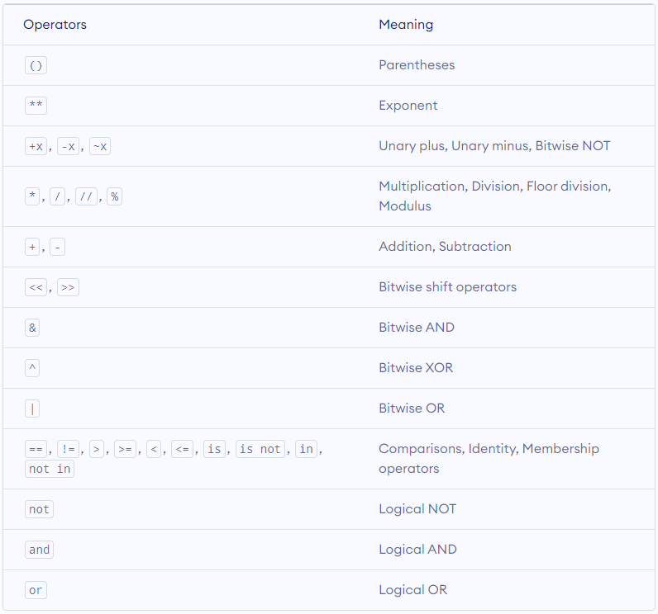

Slide 18
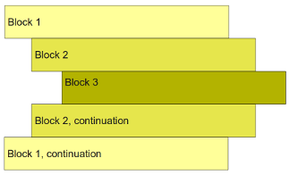
code blocks
How Python code looks like
Understand code blocks.
Indentation matters.
Understand the flow in execution of the code.

Slide 19
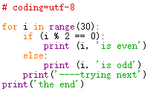
code blocks
Comments
range(30) – produce a range of integer, which is from 0 to 29
in – membership operator
for – loop each one in the list, execute next indented code block
% - modulus operator, result is remainder
== - comparison operator, if equal gives True
if – conditional statement, execute next indented block when True
else – conditional statement branch, execute next indented block when False
Try this line of code with different indent and see the result.
Loop and conditional statement, end with colon :

